Slide 1
Memory Organization:
Cache and Virtual Memory
(Lecture 59-60)

Slide 2
Fundamental concepts
Following are the fundamental concepts in understanding the performance characteristics of memory hierarchies and cache systems in computer architecture.
Hit: Occurs when the data requested by the processor is found in the cache (or memory level being accessed). This means the processor doesn't need to access a slower memory level to retrieve the data.
Miss: Occurs when the data requested by the processor is not found in the cache (or memory level being accessed), necessitating a retrieval from a slower memory level, such as main memory (RAM) or even disk storage.
Hit Rate: The percentage of all memory accesses that result in hits. It's calculated as the number of hits divided by the total number of memory accesses. The ratio of the number of hits divided by hits plus misses is the hit ratio.
Miss Rate: The percentage of all memory accesses that result in misses. As you correctly stated, it's equal to 1−Hit Rate.
Hit Time: The time required to access data when a hit occurs. This is typically much faster than accessing data from a slower memory level like RAM or disk.
Miss Penalty: The time required to process a miss. It includes the time it takes to replace a block of memory (if necessary) and the time it takes to retrieve the requested data from a slower memory level (like RAM or disk). It's the performance cost incurred when a cache miss happens.

Slide 3
Principles of Locality
An entire blocks of data is copied after a hit because the principle of locality tells us that once a byte is accessed, it is likely that a nearby data element will be needed soon. There are three forms of locality. These forms of locality are fundamental principles in computer architecture and are key factors in designing efficient cache systems and memory hierarchies
Temporal Locality: This refers to the idea that if a particular memory location is accessed, it's likely that the same location will be accessed again in the near future. This principle is based on the observation that programs often exhibit repeated access to the same data or instructions within a short time frame. Caches exploit temporal locality by keeping recently accessed data in the cache, increasing the likelihood of a hit.
Spatial Locality: Spatial locality suggests that if a memory location is accessed, neighbouring memory locations will also be accessed in the near future. This principle is based on the observation that programs tend to access memory locations that are close to each other. Caches exploit spatial locality by fetching entire blocks of contiguous memory (cache lines) into the cache upon a cache miss.
Sequential Locality: Sequential locality refers to the tendency of programs to access memory locations sequentially. This is particularly relevant for instruction fetching, where the CPU typically fetches instructions in sequential order. Caches can prefetch sequential blocks of instructions or data into the cache to exploit this locality, reducing the impact of cache misses.

Slide 4
Purpose of Cache
The purpose of cache memory is to speed up accesses by storing recently used data closer to the CPU, instead of storing it in main memory.
Although cache is much smaller than main memory, its access time is a fraction of that of main memory.
Unlike main memory, which is accessed by address, cache is typically accessed by content; hence, it is often called content addressable memory.
Because of this, a single large cache memory isn’t always desirable-- it takes longer to search.
Cache exploits the principle of locality, which includes temporal, spatial, and sequential locality.
This helps in speeding up program execution since the CPU spends less time waiting for data to be fetched from slower main memory.
Accessing data from cache consumes less power compared to accessing data from main memory. This is because cache memory is typically implemented using low-power, high-speed technologies such as static RAM (SRAM).

Slide 5
Basic Cache Operation
The basic operation of the cache is as follows.
When the CPU needs to access memory, the cache is examined. If the word is found in the cache, it is read from the fast memory.
If the word addressed by the CPU is not found in the cache, the main memory is accessed to read the word.
A block of words containing the one just accessed is then transferred from main memory to cache memory. The block size may vary from one word (the one just accessed) to about 16 words adjacent to the one just accessed.
In this manner, some data are transferred to cache so that future references to memory find the required words in the fast cache memory.
Byte addressable memory is one in which the data space in a cell is equal to 8 bits or 1 byte. It is called byte addressable memory because it uses bytewise storage configuration.
Word addressable memory is one in which the data space in a cell is equal to the word length of the CPU. It is called word addressable memory because it uses wordwise storage configuration.

Slide 6
Types of Cache Memory
Cache memory is fast and expensive. Traditionally, it is categorized as "levels" that describe its closeness and accessibility to the microprocessor. There are three general cache levels:
L1 cache, or primary cache, is extremely fast but relatively small, and is usually embedded in the processor chip as CPU cache.
L2 cache, or secondary cache, is often more capacious than L1. L2 cache may be embedded on the CPU, or it can be on a separate chip or coprocessor and have a high-speed alternative system bus connecting the cache and CPU. That way it doesn't get slowed by traffic on the main system bus.
Level 3 (L3) cache is specialized memory developed to improve the performance of L1 and L2. L1 or L2 can be significantly faster than L3, though L3 is usually double the speed of DRAM. With multicore processors, each core can have dedicated L1 and L2 cache, but they can share an L3 cache. If an L3 cache references an instruction, it is usually elevated to a higher level of cache.
In the past, L1, L2 and L3 caches have been created using combined processor and motherboard components. Recently, the trend has been toward consolidating all three levels of memory caching on the CPU itself. It is also important to know right amount of integrated L1, L2 and L3 cache while buying a CPU.

Slide 7
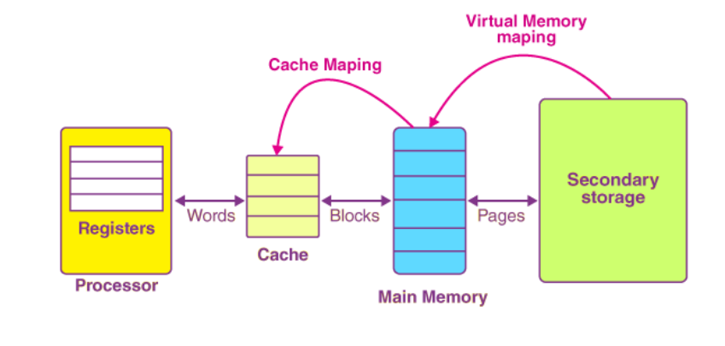
Mapping Process
The basic characteristic of cache memory is its fast access time. Therefore, very little or no time must be wasted when searching for words in the cache. The transformation of data from main memory to cache memory is referred to as a mapping process.
Cache mapping refers to a technique using which we bring the main memory into the cache memory.
Here is a diagram that illustrates the actual process of mapping:
The main memory gets divided into multiple partitions of equal size, known as the frames or blocks.
The cache memory is actually divided into various partitions of the same sizes as that of the blocks, known as lines.

Slide 8
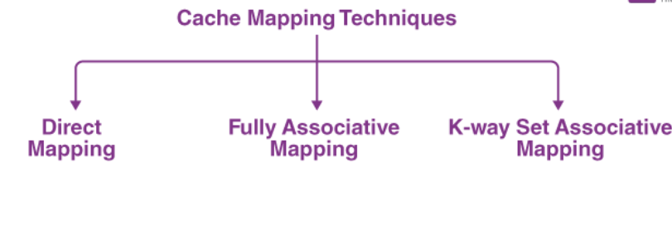
Types of Mapping
Following 3 types of mapping procedures are of practical interest when considering the organization of cache memory.
Direct mapping (each block of main memory can only be mapped to one specific cache line).
2. Associative mapping (each block of main memory can be placed in any cache line).
3. Set-associative mapping (combines the advantages of both direct and associative mapping).

Slide 9
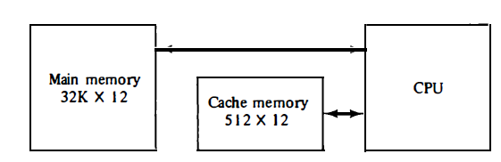
Mapping Process (Cont..)
Let us discuss these three mapping procedures by using a specific example of a memory organization as shown in below.
The main memory can store 32K words of 12 bits each.
The cache is capable of storing 512 of these words at any given time.
For every word stored in cache, there is a duplicate copy in main memory.
The CPU communicates with both memo­ries. It first sends a 15-bit address to cache.
If there is a hit, the CPU accepts the 12-bit data from cache.
If there is a miss, the CPU reads the word from main memory and the word is then transferred to cache.
Example of cache memory

Slide 10
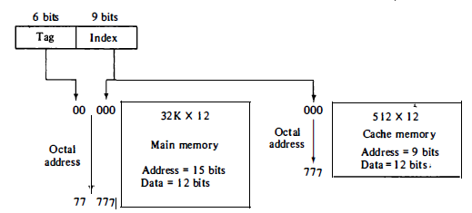
Direct Mapping
Associative memories are expensive compared to random-access memories because of the added logic associated with each cell.
The easiest technique used for mapping is known as direct mapping. In simpler words, in the case of direct mapping, we assign every memory block to a certain line in the cache. This is achieved by using part of the memory address to determine the cache location.
The possibility of using a random-access memory for the cache is investigated in below figure.
The CPU or main memory address of 15 bits is divided into two fields. The nine least significant bits constitute the index field and the remaining six bits form the tag field.
Fig: Addressing relationships between main and cache memories

Slide 11
Direct Mapping (Cont..)
The figure shows that main memory needs an address that includes both the tag and the index bits.
The number of bits in the index field is equal to the number of address bits required to access the cache memory.
Here, In a direct mapped cache consisting of N blocks of cache, block X of main memory maps to cache block Y = X mod N.
Thus, if we have 10 blocks of cache, block 7 of cache may hold blocks 7, 17, 27, 37, . . . of main memory.

Slide 12
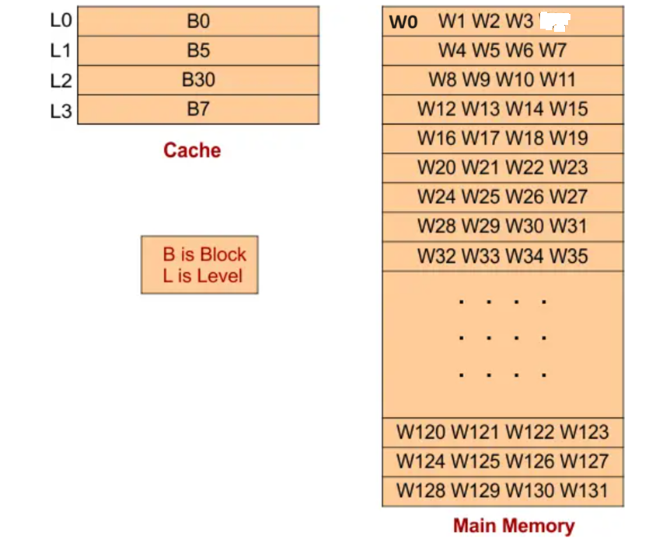
Example - Direct Mapping
Let suppose there is a Main Memory (RAM) of size 128 Words and a Cache of size 16 Words. Main Memory and Cache will be divided into equal numbers of blocks and Lines, respectively. The size of each block and Line is 4 words, as shown in the following diagram.
B0
B1
B2
B3
B4
B5
B6
B7
B29
B30
B31
With direct mapped cache consisting of N lines of cache, block no. K of main memory maps to cache block, line of cache will contain = K mod N. e.g. here N=4, Let block=0, then B0 will go line Lo so total 8 block will be in single cache line.

Slide 13
Example - Direct Mapping (Cont..)
When determining which block is in which line, the formula K MOD N is used because the block size is equal to the line size. where “K” is the Block Number and “N” is the Total number of lines in the Cache.
For example
If Block No =0, then (0 MOD 4) = 0. It means Block 0 will be in Line 0.
and If Block No =7, then (7 MOD 4) = 3. It means Block 7 will be in Line 3.
and If Block No =10, then (10 MOD 4) = 2. It means Block 10 will be in Line 2. Similarly:-
The one of the following block will be in Line zero (L0)
B0, B4, B8, B12, B16, B20, B24, B28
The One of the following blocks will be in Line zero (L1)
B1, B5, B9, B13, B17, B21, B25, B29
The One of the following blocks will be in Line zero (L2)
B2, B6, B10, B14, B18, B22, B26, B30
The One of the following blocks will be in Line zero (L3)
B3, B7, B11, B15, B19, B23, B27, B31

Slide 14
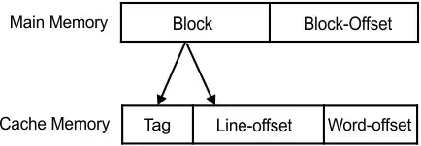
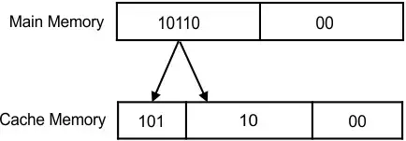
Example - Direct Mapping (Cont..)
From the last figure, to represent 128 words (2^8) we need 7 bits and to represent 32 blocks (2^5) =128/4 we need 5-bits.
To represent 4-words (2^2) in a block of main memory we need 2-bits called block offset.
To represent 4 lines (2^2) in cache memory, 2 bits are required and called line offset. All can be represented in following format.
To represent tag, balance 3 bits are used, total 2^3, 8 blocks.
For Example, if an address of Word 0 of block 22 in the main memory is (10110 00) given below

Slide 15
Searching for a block through Tag (Cache Hit or miss)
Suppose the CPU generates an address 0001010 or 10 in decimal for 128-word main memory. The first two bits (10) represent the Block offset, the next two bit (10) are used to represent the Line number, and the last three bits (000) represents the Tag in Cache memory.
To find the Particular block in cache memory
First, find the line where the required Block is present in cache memory which is 01 or 1 or B1
Second, Compare the tag bits of the generated address with the tag bits of the line where the actual Block is present. If it matches, then Cache Hit; otherwise, cache miss. Tag bits are 001 i.e. 1

Slide 16
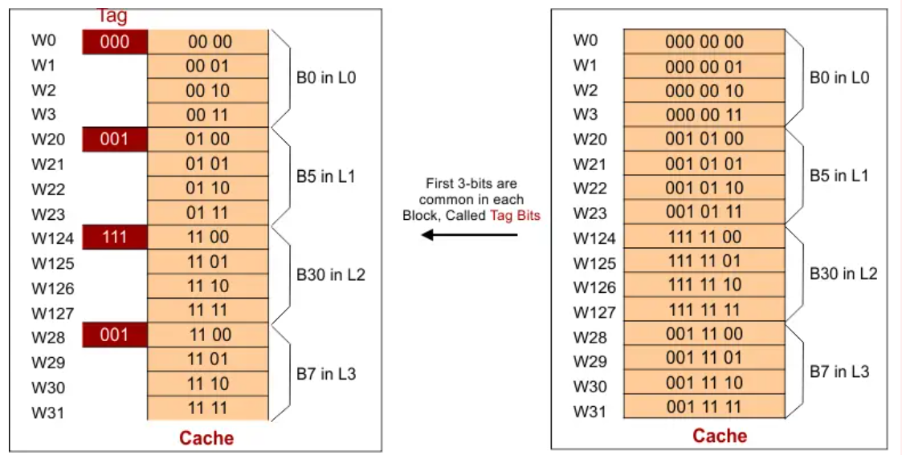
Example: Cache Hit or Miss
Example: For address 0010100 in the following diagram; it is a cache, Hit. But if the address is 1010011, then it is a cache miss because the last three Tag bits (101) are not found in the tag bits of cache lines.

Slide 17
Questions – Direct Mapping
Q59.1: If we have 8 words in the block and each word is of 32-bit, how many Bits are required for Block offset? Main memory is byte-addressable.
Total words in a block* size of word in bytes = 8*4= 32= 2^5 So, 5 bits are required for Block Offset/Line offset
Q59.2. If we have 8 words in the block and each word is of 32 bit, then how many Bits required for Block offset? Main memory is word addressable.
Total words = 8 = 2^3 So, 3 bits are required for Block Offset/Line offset
Q59.3. If the cache size is 64KB and the Block/Line size is 8, then how many bits are required to represent lines of cache memory
Total lines = Cache size/Block size = 64KB/8 = 2^13 So, 13 bits are required to represent lines in the cache
Q59.4. if we have PA, Block Offset, and Line Bits, then we can calculate Tag through the following equation in Direct Mapping.
Physical Address (PA) = Block Offset + Line + Tag
Consider a directly mapped cache of size 32 KB with a block size of 32 bytes. The CPU generated 32-bit addresses. Find the number of bits required for cache indexing and tag bits, respectively.

Slide 18
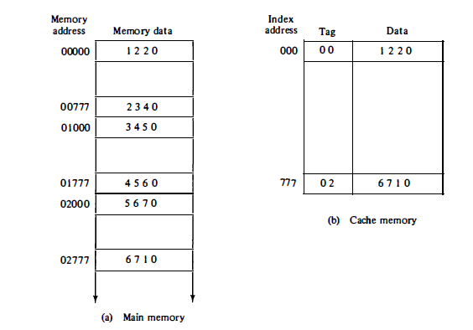
Direct Mapping (Cont..)
In the general case, there are 2^k words in cache memory and 2^n words in main memory. The n-bit memory address is divided into two fields: k bits for the index field and n - k bits for the tag field.
The direct mapping cache organization uses the n-bit address to access the main memory and the k-bit index to access the cache.
The internal organization of the words in the cache memory is as shown below.
Fig: Direct mapping cache organization

Slide 19
Direct Mapping (Cont..)
Each word in cache consists of the data word and its associated tag.
When a new word is first brought into the cache, the tag bits are stored alongside the data bits.
When the CPU generates a memory request, the index field is used for the address to access the cache. The tag field of the CPU address is compared with the tag in the word read from the cache.
If the two tags match, there is a hit and the desired data word is in cache. If there is no match, there is a miss and the required word is read from main memory. It is then stored in the cache together with the new tag, replacing the previous value.
The disadvantage of direct mapping is that the hit ratio can drop considerably if two or more words whose addresses have the same index but different tags are accessed repeatedly.
However, this possibility is minimized by the fact that such words are relatively far apart in the address range (multiples of 512 locations in this example).

Slide 20
Numerical Example -Direct Mapping
To see how the direct-mapping organization operates, consider the numerical example using a block size of one word.
The word at address zero is presently stored in the cache (index = 000, tag = 00, data = 1220) as shown in previous silde.
Suppose that the CPU now wants to access the word at address 02000. The index address (last 3 digits of 5 digits main memory address) is again 000, so it is used to access the cache.
The two tags are then compared. The cache tag is 00 as shown in cache memory with index address, 000 but the address tag is 02 as shown in main memory, which does not produce a match.
Therefore, the main memory is accessed and the data word 5670 is transferred to the CPU.
The cache word at index address 000 is then replaced with a tag of 02 and data of 5670.

Slide 21
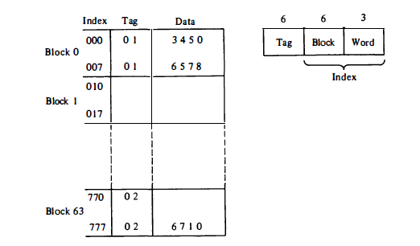
Direct Mapping (with block size of multi words)
Direct Mapping using a block size of multi (8) words as shown below.
Note: The index field is now divided into two parts (earlier this was not divided): the block field and the word field.
In a 512-word (64 x 8) cache there are 64 blocks of 8 words each.
The block number is specified with a 6-bit field and the word within the block is specified with a 3-bit field.
The tag field stored within the cache is common to all 8 words of the same block.
Every time a miss occurs, an entire block of eight words must be transferred from main memory to cache memory. Although this takes extra time, the hit ratio will most likely improve with a larger block size because of the sequential nature of computer programs.
Fig: Direct mapping cache with block size of 8 words.

Slide 22
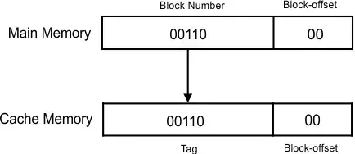
Associative Mapping
In fully associative mapping, each memory block is mapped to any cache line. It resolves the issue of conflict miss. This means that any main memory block can come in any cache memory line. For example, B0 can come in L1, L2, L3, and L4; the same is true for all other blocks. In this way, the chance of a cache hit is increased.
It helps to make this fastest and most flexible cache organization than direct mapping.
Suppose there is a Main Memory (RAM) of size 128 Words and a Cache of size 16. Main Memory and Cache are divided into blocks and Lines, respectively. The size of each block Line is 4 words, as shown in the direct mapping diagram. As the main memory size is 128 words, therefore 7 bits will be used to represent the main memory. So, the Physical address will be of 7 bits. An example of fully associative mapping of W24 of B6 is given below

Slide 23
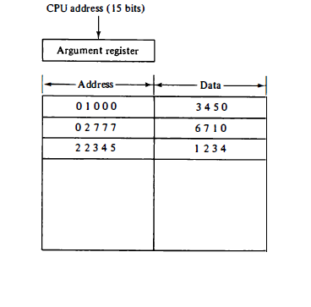
Associative Mapping (Cont..)
First 2 bits are required to represent 4 words of Block.
5 bits are required to represent 32 blocks.
We do not need to divide Block Number into Line No and Tag because any main memory block can come in any cache Line. So, Block No is our Tag.
Associative mapping organization is shown below in which associative memory stores both the address and content (data) of the memory word.
This permits any location in cache to store any word from main memory
Fig: Associative mapping cache (all numbers in octal).

Slide 24
Associative Mapping (Cont..)
The address value of 15 bits is shown as a five-digit octal number and its corresponding 12 -bit word is shown as a four-digit octal number.
A CPU address of 15 bits is placed in the argument register and the associative memory is searched for a matching address.
If the address is found, the corresponding 12-bit data is read and sent to the CPU. If no match occurs, the main memory is accessed for the word.
The address - data pair is then transferred to the associative cache memory. If the cache is full, an address--data pair must be displaced to make room for a pair that is needed and not presently in the cache.
The decision as to what pair is replaced is determined from the replacement algorithm that the designer chooses for the cache.
A simple procedure is to replace cells of the cache in round-robin order whenever a new word is requested from main memory. This constitutes a first-in first-out (FIFO) replacement policy.

Slide 25
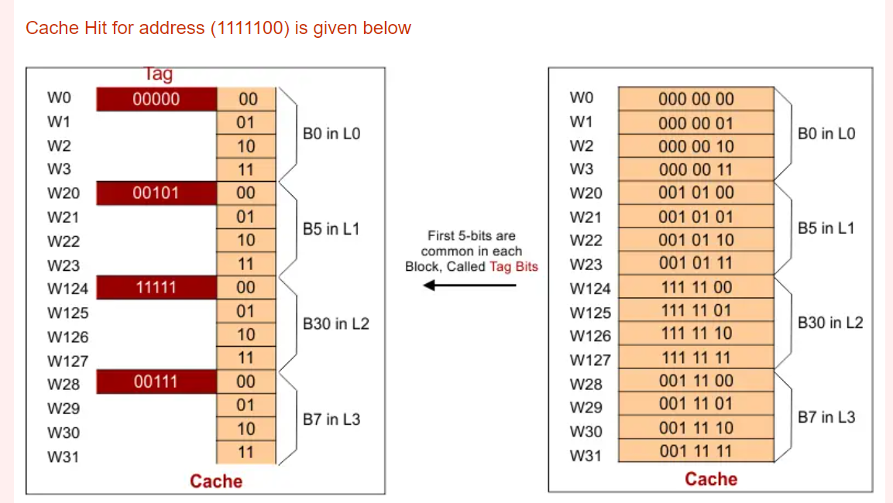
Searching for block through Tag (Cache Hit or Miss)
Suppose the CPU generates an address 1111100 for 128-word main memory.
The first two bits (00) represent Block offset, and the last five bits (11111) represent the Tag in Cache memory.
As required, the word of the memory block can be present in any line of cache, so the number of the comparator is increased. We match the tag of the given address with the tag of all cache lines. If it matches, then it is a cache hit case; otherwise, it is a cache miss case.

Slide 26
Set-Associative Mapping
It was mentioned previously that the disadvantage of direct mapping is that two words with the same index in their address but with different tag values cannot reside in cache memory at the same time.
A third type of cache organization, called set-associative mapping, is an improvement over the direct mapping organization in that each word of cache can store two or more words of memory under the same index address.
Each data word is stored together with its tag and the number of tag-data items in one word of cache is said to form a set.
An example of a set-associative cache organization for a set size of two is shown in next slide.
Each index address refers to two data words and their associated tags.
Each tag requires six bits and each data word has 12 bits, so the word length is 2(6 + 12) = 36 bits.
An index address of nine bits can accommodate 512 words. Thus the size of cache memory is 512 x 36.
It can accommodate 1024 words of main memory since each word of cache contains two data words. In general, a set-associative cache of set size k will accommodate k words of main memory in each word of cache.

Slide 27
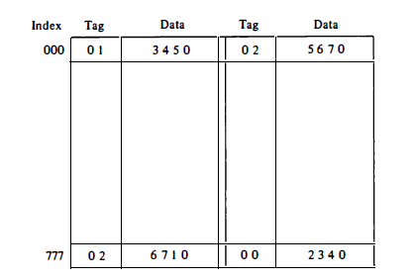
Set-Associative Mapping (Cont..)
The octal numbers listed in below figure are with reference to the main memory contents illustrated in Figure of Direct mapping cache organization.
The words stored at addresses 01000 and 02000 of main memory are stored in cache memory at index address 000.
Similarly, the words at addresses 02777 and 00777 are stored in cache at index address 777.
Fig: Two-way set-associative mapping cache

Slide 28
Set-Associative Mapping (Cont..)
When the CPU generates a memory request, the index value of the address is used to access the cache. The tag field of the CPU address is then compared with both tags in the cache to determine if a match occurs.
The comparison logic is done by an associative search of the tags in the set similar to an associative memory search: thus the name "set-associative."
The hit ratio will improve as the set size increases because more words with the same index but different tags can reside in cache. However, an increase in the set size increases the number of bits in words of cache and requires more complex comparison logic.
When a miss occurs in a set-associative cache and the set is full, it is necessary to replace one of the tag-data items with a new value. The most common replacement algorithms used are: random replacement, first-in first-out (FIFO), and least recently used (LRU).
With the random replacement policy the control chooses one tag-data item for replacement at random. The FIFO procedure selects for replacement the item that has been in the set the longest.
The LRU algorithm selects for replacement the item that has been least recently used by the CPU.
Both FIFO and LRU can be implemented by adding a extra bits in each word of cache.

Slide 29
Writing into Cache
During a read operation, when the CPU determines a word in the cache, the main memory is not included in the transfer. However, if the operation is a write, there are two ways that the system can proceed.
1. Write Through Method : The simplest and most commonly used procedure is to update main memory with every memory write operation, with cache memory being updated in parallel if it contains the word at the specified address. This is called the write-through method. This method has the advantage that main memory always contains the same data as the cache.
2. Write Back Method : During this operation, only the cache location is updated during write operation. Then, the location is marked by a flag so that it is later copied to the main memory when the word is removed from the cache. The reason for the write-back method is that during the time a word resides in the cache, it may be updated several times; however, as long as the word remains in the cache, it does not matter whether the copy in main memory is out of date, since requests from the word are filled from the cache. It is only when the word is displaced from the cache that an accurate copy need be rewritten into main memory.

Slide 30
Cache Initialization
One of the aspect of cache organization that must be taken into consideration is the problem of initialization.
The cache is initialized when power is applied to the computer or when the main memory is loaded with a complete set of programs from auxiliary memory.
After initialization the cache is considered to be empty, but in effect it contains some nonvalid data. It is customary to include with each word in cache a valid bit to indicate whether or not the word contains valid data.
The cache is initialized by clearing all the valid bits to 0. The valid bit of a particular cache word is set to 1 the first time this word is loaded from main memory and stays set unless the cache has to be initialized again.
The introduction of the valid bit means that a word in cache is not replaced by another word unless the valid bit is set to 1 and a mismatch of tags occurs.
If the valid bit happens to be 0, the new word automatically replaces the invalid data.
Thus the initialization condition has the effect of forcing misses from the cache until it fills with valid data.

Slide 31
Virtual Memory
Virtual memory refers to a memory management method where computers use secondary memory to compensate for the scarcity of physical memory. The technique is exploited by a computer’s operating system (OS) in situations when the system lacks sufficient RAM to execute instructions. With virtual memory, computers can run complex and sophisticated programs as the conflicting memory demands of multiple programs are met within a fixed memory space.
In a memory hierarchy system, program or data are brought into main memory as they are needed by the CPU. Virtual memory is a concept used in some large computer systems that permit the user to construct programs as though a large memory space were available, equal to the totality of auxiliary memory.
Each address that is referenced by the CPU goes through an address mapping from the so-called virtual address to a physical address in main memory.
Virtual memory is used to give programmers the illusion that they have a very large memory at their disposal, even though the computer actually has a relatively small main memory.
A virtual memory system provides a mechanism for translating program-generated addresses into correct main memory locations. This is done dynamically, while programs are being executed in the CPU. The translation or mapping is handled automatically by the hardware by means of a mapping table.

Slide 32
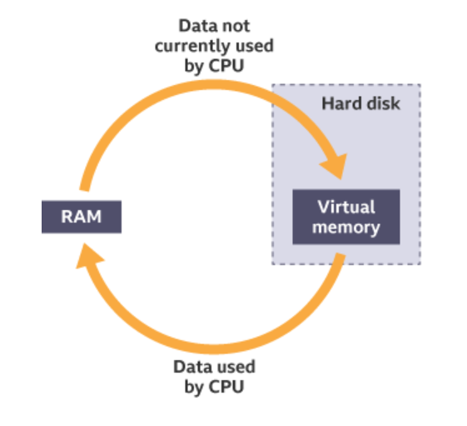
How does Virtual Memory work?
The working mechanism of virtual memory involves a process called ‘swapping’.
Virtual memory enables data that is in RAM and not currently being used to be transferred to the hard disk. This frees up room in RAM for other programs and data. When the data on the hard disk is needed again, any other unused data is transferred to the hard disk before the original data is transferred back to RAM. This process is known as swapping.
This swapping process happens so quickly that users do not notice any delay.
Using virtual memory makes a computer run slower, as the processor has to wait while data is swapped between hard disk and RAM. As secondary storage devices have slower access times than RAM, the computer's processing performance can be severely impaired. Processing performance can be improved by increasing the size of the RAM, thereby reducing the need for virtual memory.

Slide 33
Address Space and Memory Space
An address used by a programmer will be called a virtual address, and the set of such addresses the address space .
An address in main memory is called a location or physical address . The set of such locations is called the memory space .
Thus the address space is the set of addresses generated by programs as they reference instructions and data; the memory space consists of the actual main memory locations directly addressable for processing. In most computers the address and memory spaces are identical.
The address space is allowed to be larger than the memory space in computers with virtual memory.
As an illustration, consider a computer with a main-memory capacity of 32K words (K = 1024). Fifteen bits are needed to specify a physical address in memory since 32K = 2^15. Suppose that the computer has available auxiliary memory for storing 2^20 = 1024K words. Thus auxiliary memory has a capacity for storing information equivalent to the capacity of 32 main memories.
Denoting the address space by N and the memory space by M, we then have for this example N = 1024K and M = 32K as shown in the figure on next slide.
At the fundamental level, virtual memory maps program addresses to RAM. In cases where there’s not enough RAM space, the programs are mapped to disk.

Slide 34
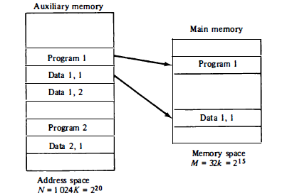
Address Space and Memory Space
.
Relation between address and memory space in virtual memory

Slide 35
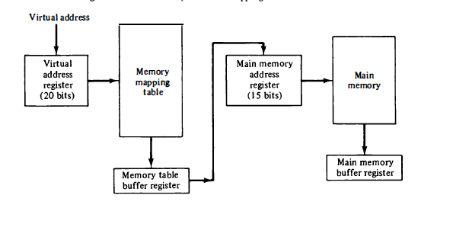
Address Space and Memory Space
.
Memory Table for mapping a virtual address

Slide 36
Virtual Memory Implementation
.
Virtual memory is implemented using 2 techniques.
1. Demand Paging and 2, Demand Segmentation.
Demand Paging: Demand paging is a type of swapping that is done in virtual memory systems. Demand paging as it says from the title, only copies data from the disk to the RAM if the data is required by some program, therefore meaning that the data will not be when the data is already available on the memory. This can be referred to as “lazy evaluation”, because only the demanded pages of memory are being swapped from the secondary storage (disk space) to the main memory.
Another type of paging which virtual memory uses is Anticipatory Paging, this is when the operating system attempts to anticipate data that will be needed next and copies it to the RAM before it is actually required.

Slide 37
Virtual Memory Implementation
.
The process of Demand paging:
Page table: A page table is the data structure used by a virtual memory system in a computer operating system to store the mapping between visual address and physical addresses.
The mapping from address space to memory space is facilitated
The CPU generates an interrupt indicating memory access fault if the CPU tries to refer a page that is currently not available in the main memory.
The operating systems places the interrupted process in a blocking state. Though for the execution to proceed, the operating system must bring the required page into the memory.
The operating system will search for the required page in the logical address space.
The page that is required will be brought to the physical address from the logical address. Page replacement algorithms are used for the decision making of replacing the page in physical address space.
The page table will be updated accordingly.
A signal will then be sent to the CPU to continue the election of the program and it will place the process back into the ready state.
Therefore, whenever a page fault occurs, the steps above are followed by the operating system and the required page is brought back into memory.
Memory Table for mapping a virtual address

Slide 38
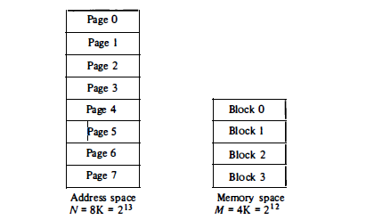
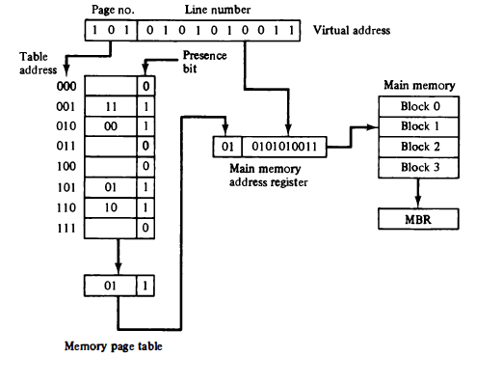
Virtual Memory Implementation
Address space and memory space split into groups of lK words.
Consider a computer with an address space of 8K and a memory space
of 4K. If we split each into groups of 1K words we obtain eight pages and four
blocks as shown in Fig. 12-18. At any given time, up to four pages of address
space may reside in main memory in any one of the four blocks.
Memory Table in page system. The organization of the memory mapping table in a paged system is
shown in Fig. The memory-page table consists of eight words, one for each page

Slide 39
Demand Segmentation
Another approach to efficient memory management is that of segmentation. Instead of allocating fixed-size pages to processes, memory segments of varied lengths are assigned to computing operations based on their memory needs. In contrast to paging, segmentation does not waste memory segments.
With segmentation, applications can split up into different logical address spaces. As a result, applications become shareable and more secure. However, segmentation often leads to ‘memory fragmentation.’ Memory segments are of different lengths, and the allocation and deallocation of these segments result in many unused memory spaces. As their length is not defined, memory is left unattended by processes owing to their varying size.
As such, unused portions of segments pile up, and the OS can allocate them to processes. However, if they are scattered around, it can be troublesome for the OS to keep track of all these memory chunks. Moreover, if processes are forced into using different segment portions, it can degrade system performance due to inefficient memory allocation approaches.

Slide 40
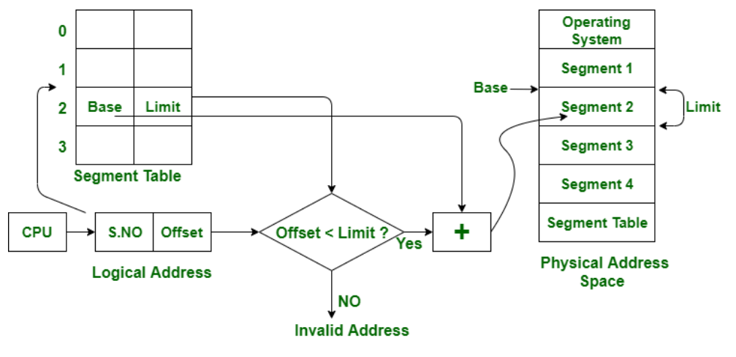
Translation of a logical address to a physical address
In segmentation, the CPU generates a logical address that contains the Segment number (S.No.) and segment offset (Offset). If the segment offset < limit then the address called valid address otherwise it throws miscalculation because the address is invalid.
The partitions of secondary memory area units are known as segments.
The details concerning every segment are hold in a table known as segmentation table.
Segment table contains two main data concerning segment, Base, which is the bottom address of the segment and another is Limit, which is the length of the segment.

Slide 41
Difference between Paging and segmentation
Paging | Segmentation
In paging, the program is divided into fixed or mounted size pages. | In segmentation, the program is divided into variable size sections.
For the paging operating system is accountable. | For segmentation compiler is accountable.
Page size is determined by hardware. | Here, the section size is given by the user.
It is faster in comparison to segmentation. | Segmentation is slow.
Paging could result in internal fragmentation. | Segmentation could result in external fragmentation.
In paging, the logical address is split into a page number and page offset. | Here, the logical address is split into section number and section offset.
Paging comprises a page table that encloses the base address of every page. | While segmentation also comprises the segment table which encloses segment number and segment offset.
Paging is invisible to the user. | Segmentation is visible to the user.
It is hard to allow sharing of procedures between processes. | Facilitates sharing of procedures between the processes.
In paging, a programmer cannot efficiently handle data structure. | It can efficiently handle data structures.
The size of the page needs always be equal to the size of frames. | There is no constraint on the size of segments.
A page is referred to as a physical unit of information. | A segment is referred to as a logical unit of information.
.

Slide 42
Paging Replacement Algorithms
OPT(MIN) : eliminate the page that be not expected to be used.
FIFO(first input/first output) : rather than choosing the victim page at random, the oldest page is the first to be removed.
LRU(Least Recently used) : move out the page that is the least rarely used.
LFU(Least Frequently used) : move out the page that is not used often in the past.

Slide 43
Memory Management Unit
In a multiprogramming environment where many programs reside in memory it becomes necessary to move programs and data around the memory, to vary the amount of memory in use by a given program, and to prevent a program from changing other programs.
The demands on computer memory brought about by multiprogramming have created the need for a memory management system. A memory management system is a collection of hardware and software procedures for managing the various programs residing in memory.
The memory management software is part of an overall operating system available in many computers.
The basic components of a memory management unit are:
1. A facility for dynamic storage relocation that maps logical memory references into physical memory addresses
2. A provision for sharing common programs stored in memory by different users
3. Protection of information against unauthorized access between users and preventing users from changing operating system functions

Slide 44
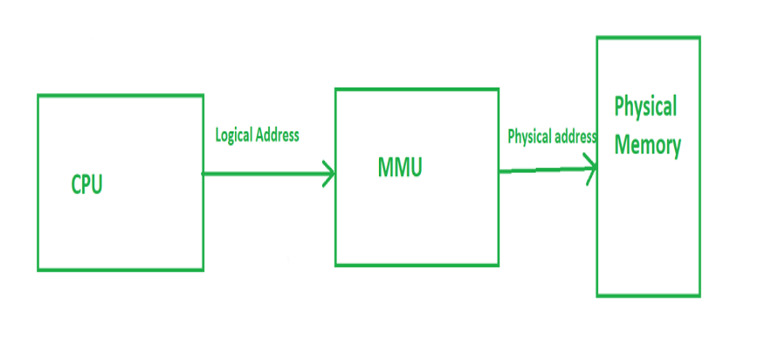
Memory Management Unit (Cont..)
MMU or hardware unit acts as a bridge between the CPU and the RAM, which ensures that programs can run smoothly and access the required data without clashes or unauthorized access. It is usually integrated in the processor but in some cases it also constructed as a separate IC.

Slide 45
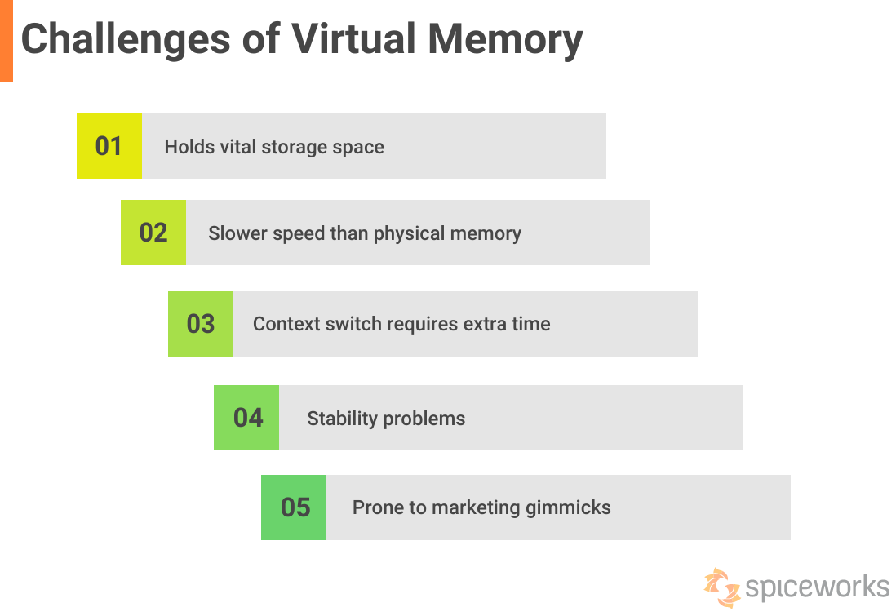
Paging replacement algorithms

